Slide 1
Ship- and boat-building industries
Rob Hendrickson, MD

Slide 2
Objectives
Industry
Process, jobs, and toxicity associated with:
  Shipbuilding
  Boatbuilding
  Ship breaking

Slide 3
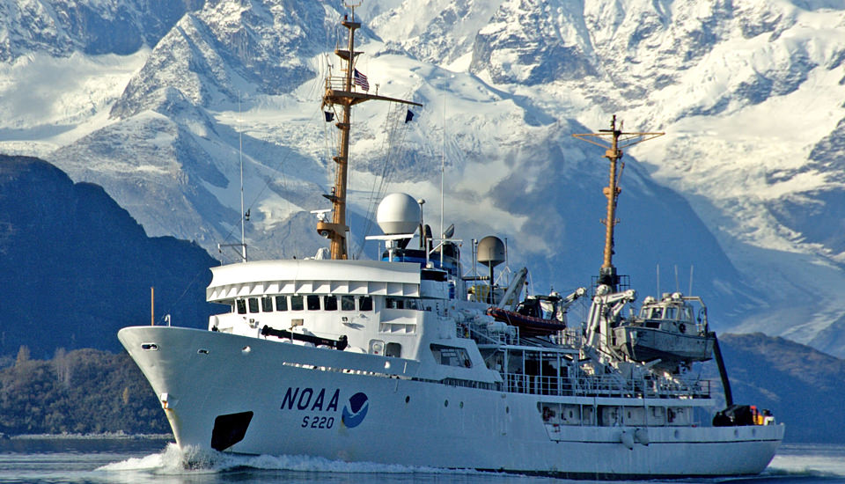
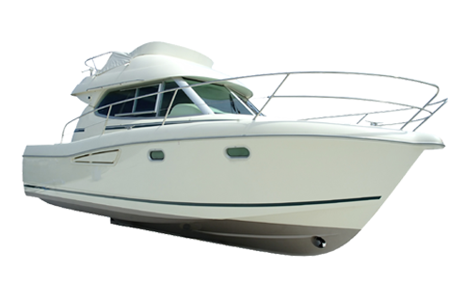
Ship vs. Boat
Notes:
Purposes of this discussion:
ship = metal hull
boat = fiberglass hull

Slide 4
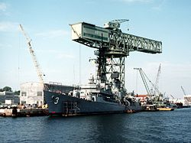
Industry
U.S.
  First Tier (6), (ships > 383 feet)
  569 total shipyards
  111,905 employees
US$25 billion
Spring 2015 Industry Study; Shipbuilding, Dwight D. Eisenhower School for National Security and Resource Strategy; National Defense University;
http://es.ndu.edu/Portals/75/Documents/industry-study/reports/2015/es-is-report-shipbuilding-2015.pdf

Slide 5
Industry
Shipbuilding and repairing industry in Thailand; Thai Shipbuilding and repairing industry; www.asef2015.com/asef2007/PDF/3.%20Shipbuilding_Industry_in_Thailand.pdf

Slide 6
Shipbuilding and repairing industry in Thailand; Thai Shipbuilding and repairing industry; www.asef2015.com/asef2007/PDF/3.%20Shipbuilding_Industry_in_Thailand.pdf

Slide 7
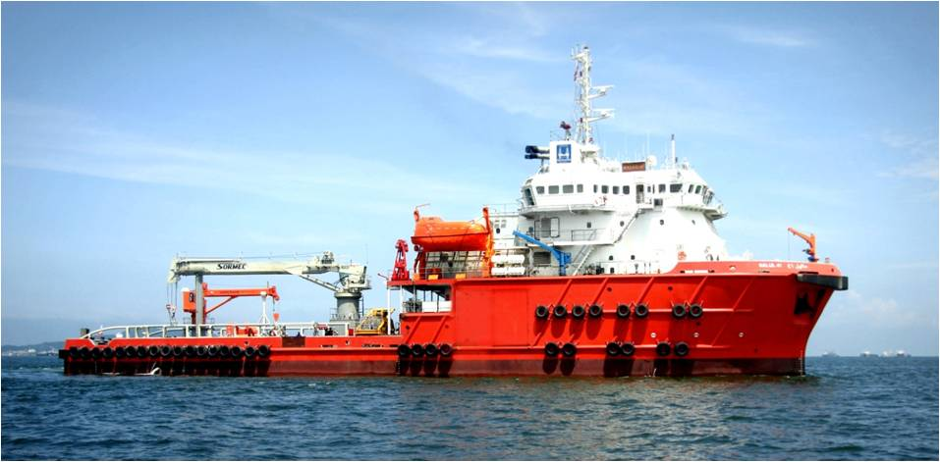
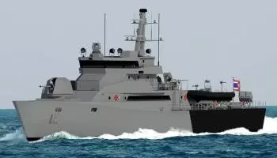
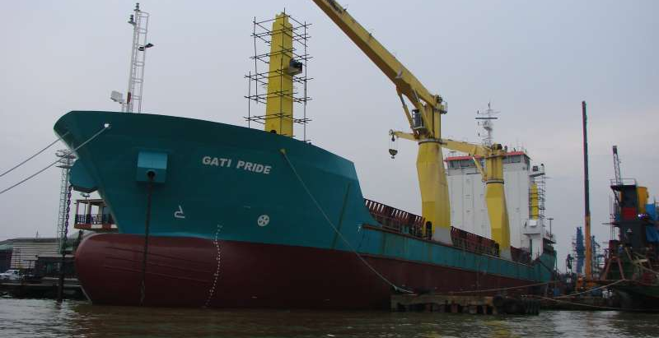
Shipbuilding - Thailand
Offshore support vessels
Naval vessels
Merchant vessels
Notes:
250 offshore platforms operating in the Gulf of Thailand

Slide 8
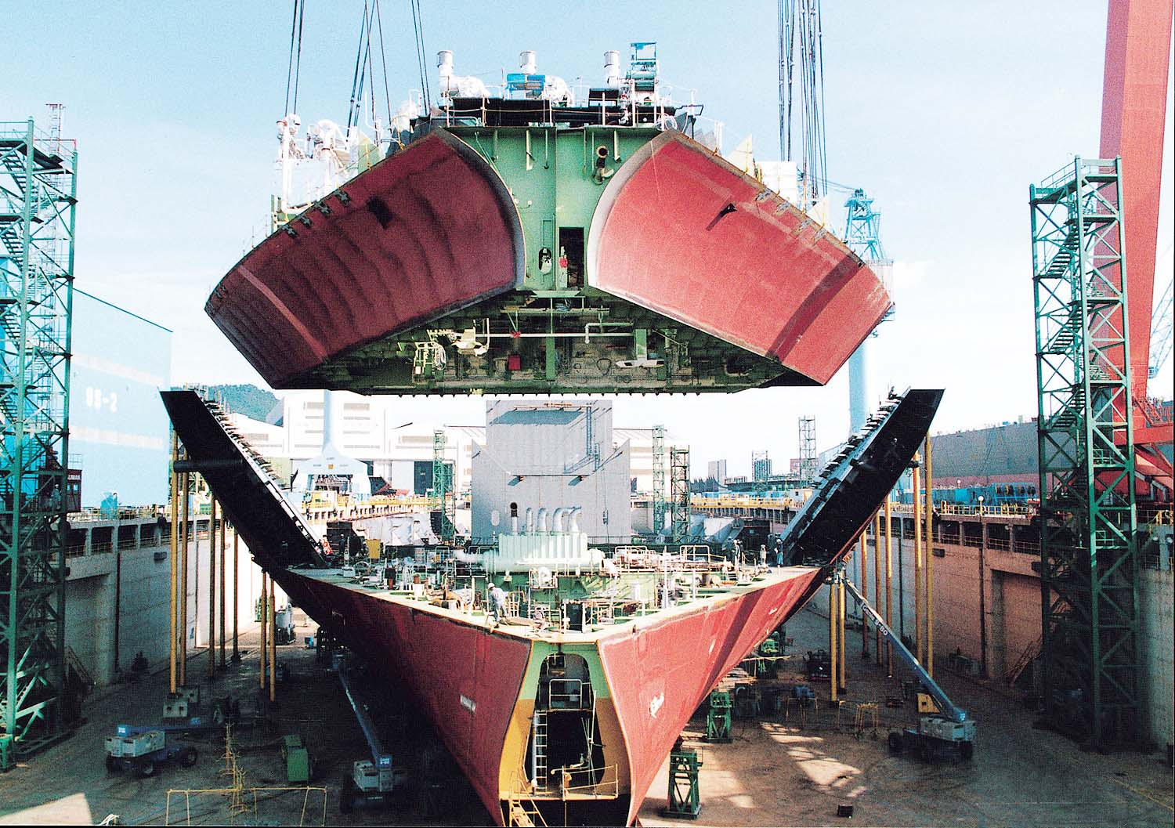
Process
Huge industry with many varied skilled laborers
Hull block construction method

Slide 9
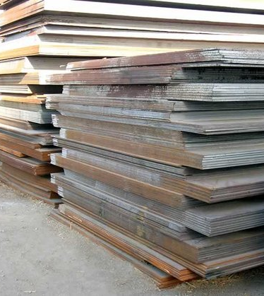
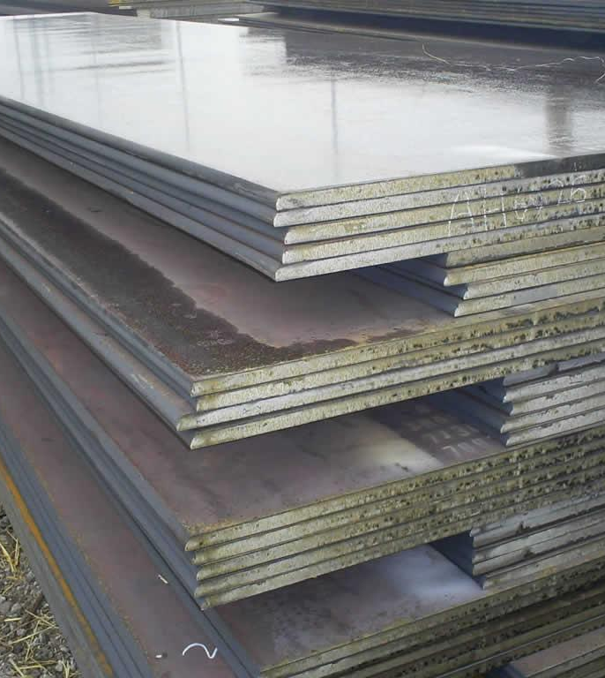
Process

Slide 10
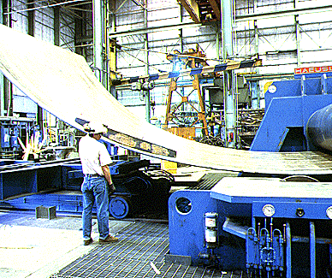
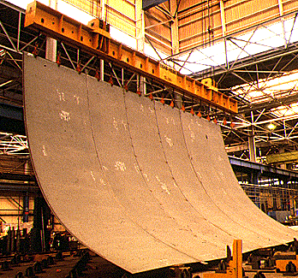
Process

Slide 11
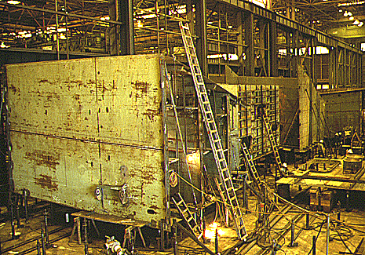
Process

Slide 12
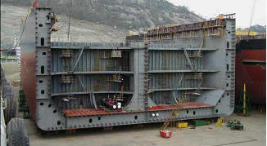
Process

Slide 13
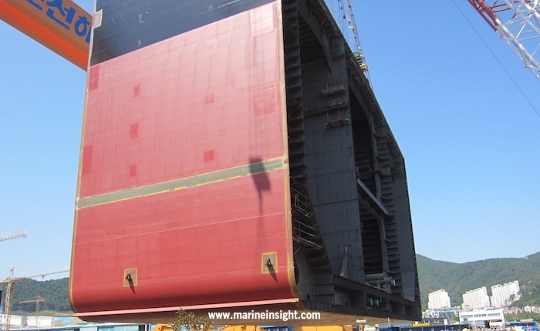
Process

Slide 14
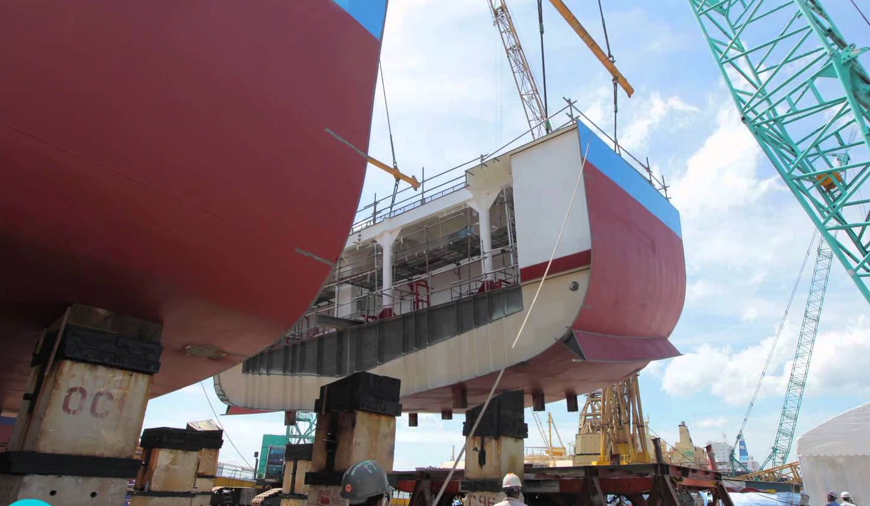
Process

Slide 15
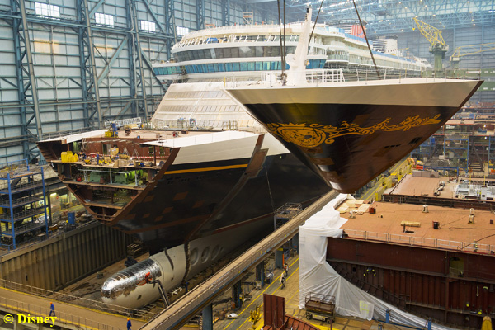
Process

Slide 16
Process
Some example jobs:
  Small parts production / paint removal
  Welders
  Machining
  Painters
  Electricians
  Pipefitters
  Laggers

Slide 17
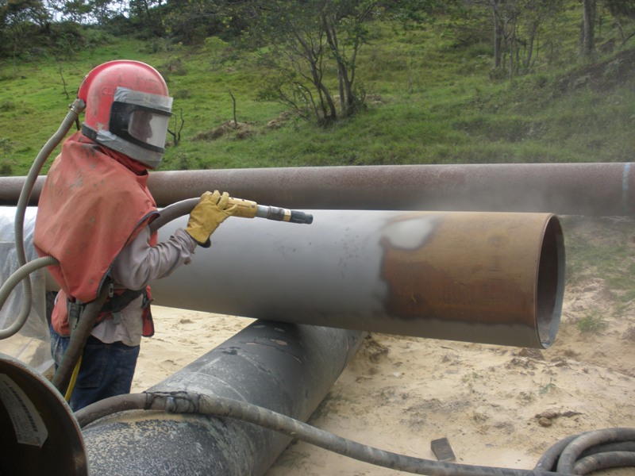
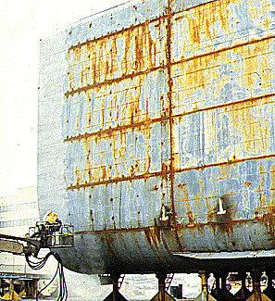
Process
Paint removal/Steel prep
  Solvents / degreasers
  Pickling(rust protection) – dip tanks of heated caustic soda, alkali rinse (pH 8-13), heated sulfuric acid, phosphoric acid
  Blasting
    Metal filings, copper slag, steel grit or shot, or sand (silica).
Notes:
Blasting – Sand, metal filings, copper slag, steel grit or shot.
Solvents – acute inebriation, lightheadedness; chronic neurologic

Slide 18
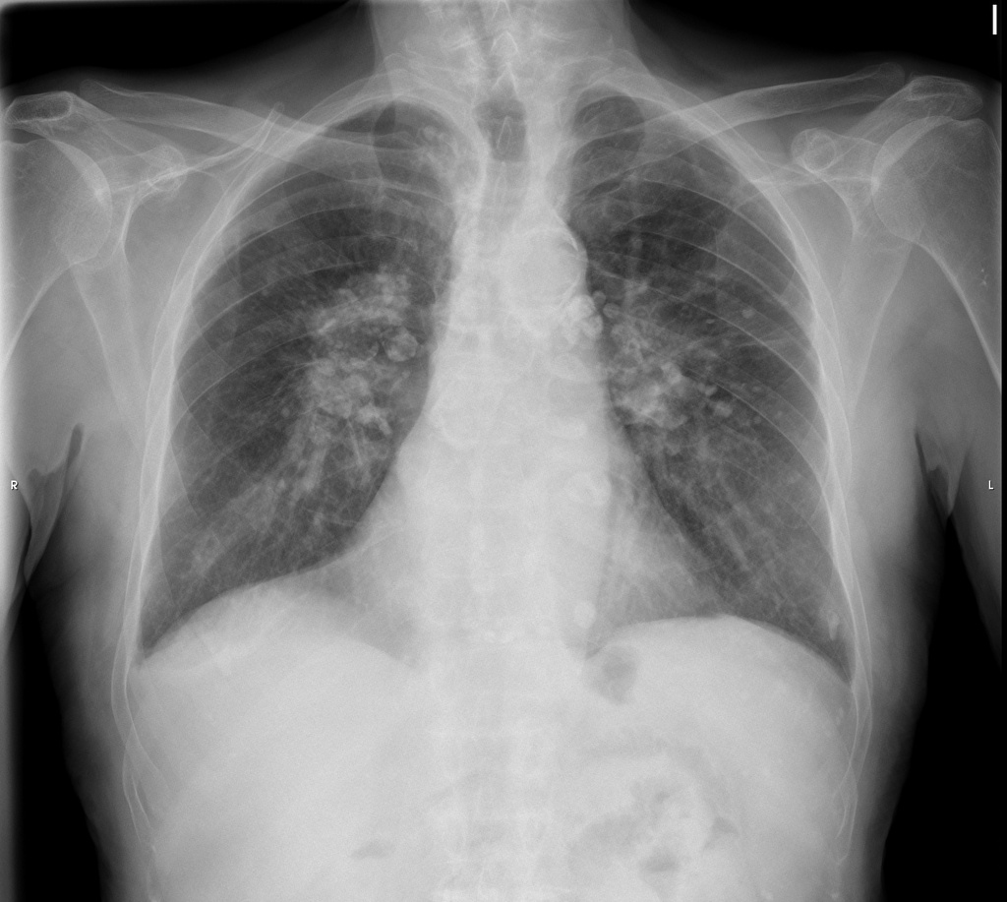
Simple Silicosis
Crystalline silica 0.5-3 micrometers
Ingested by macrophages
  -> inflammatory mediators
CXR nodular opacities
Pulmonary testing:
  Restrictive pattern
    Decreased FEV1, FVC, TLC
Notes:
Blasting – Sand, metal filings, copper slag, steel grit or shot.

Slide 19
Simple Silicosis
Notes:
Annual CXR, PFTs, and medical examination

Slide 20
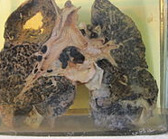
Silicosis
Chronic simple silicosis
  >10 years; <1cm nodules
Accelerated silicosis
  5-10 years; progress rapidly
Complicated silicosis
  Progressive massive fibrosis; >1cm nodules
Acute
  Weeks-5years; ground-glass; alveolar silica
Notes:
Blasting – Sand, metal filings, copper slag, steel grit or shot.

Slide 21
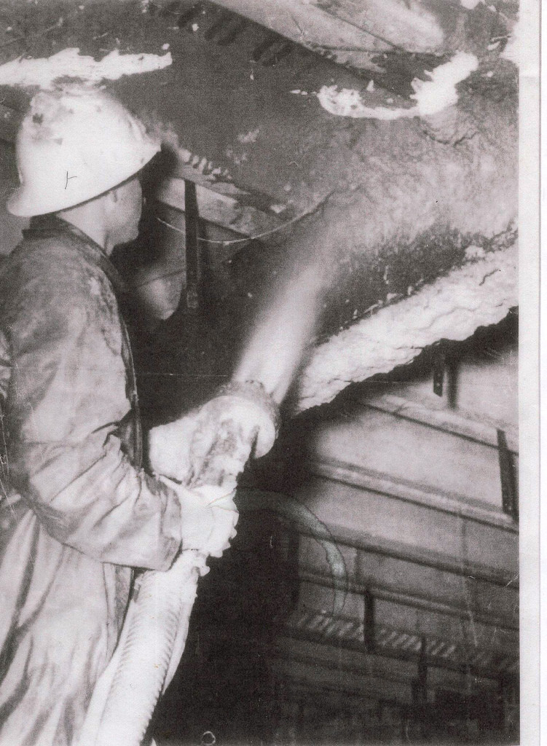
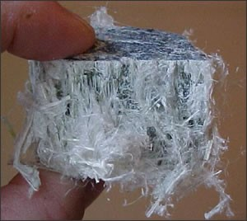
Process
Laggers
  Apply asbestos / MMFs to pipes and surfaces
Notes:
Welding – joining 2 pieces of metal

Slide 22
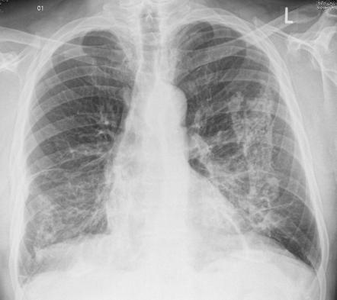
Asbestos
Replaced by MMFs in 1975 in US
Asbestosis – diffuse interstitial fibrosis
  Dose response
  Latency of 20-40 years
  More frequent in smokers
  “frustrated macrophage” theory
  PFTs – restrictive lung disease, decreased diffusion
  Cancer – lung cancer, mesothelioma
Notes:
Monitoring – annual exam, CXR, PFTs, PPD

Slide 23
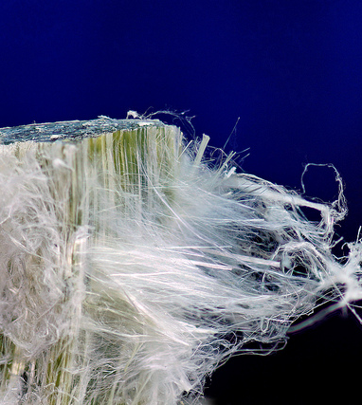
MMMFs
Man made mineral fibers
  Skin/respiratory irritant
  Chronic bronchitis
  Elevated risk of small CXR opacities
  No clear risk with cancer
Notes:
Welding – joining 2 pieces of metal

Slide 24
Process
Welders
  Enclosed spaces, poor ventilation
  CO, ozone, NO2
  Metals (iron, lead, arsenic, manganese, zinc, nickel, chromium, cobalt, copper)
    Leaded paint (military vessels)
  Chemicals released from metal surface: solvents, phosgene, fluoropolymers, degreasers, fuels
Notes:
Welding – joining 2 pieces of metal

Slide 25
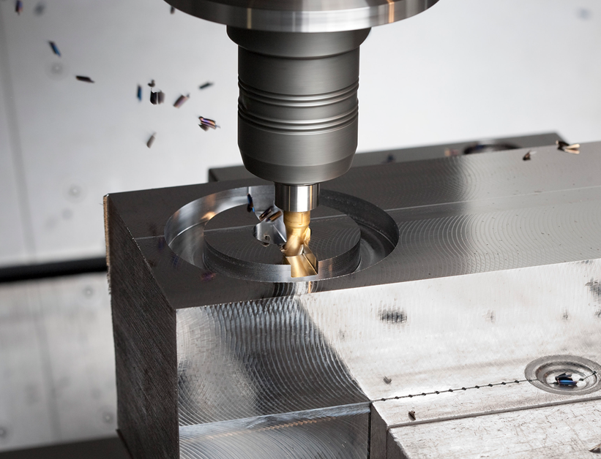
Process
Machining
  Drilling, grinding, and milling
  Cutting fluids/oils, lubricants, greases, solvents
Notes:
Welding – joining 2 pieces of metal

Slide 26
Process
Painters
  Leaded and unleaded paint
  Exposure to asbestos/MMF, paint thinners, resins
  Marine paint
    Anti-fouling paints
      Copper paint – hemolysis, hepatotoxicity, renal toxicity
      Organotin / tributyltin oxide – MM irritation,
      “Hard bottom paints”
        Teflon – polymer fume fever
Notes:
Welding – joining 2 pieces of metal

Slide 27

Process
Electricians
  Enclosed spaces
  Exposed to welding fumes, asbestos/MMFs, when in proximity to welders, pipefitters, etc
Notes:
Welding – joining 2 pieces of metal

Slide 28
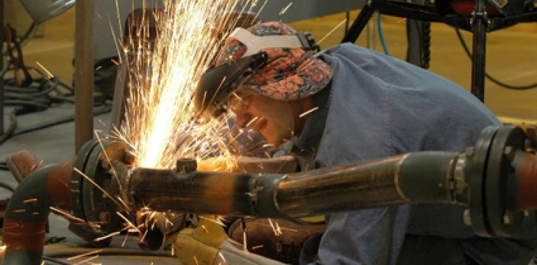
Process
Pipefitters
  Welding, boring
  Asbestos/MMFs
Notes:
Welding – joining 2 pieces of metal

Slide 29
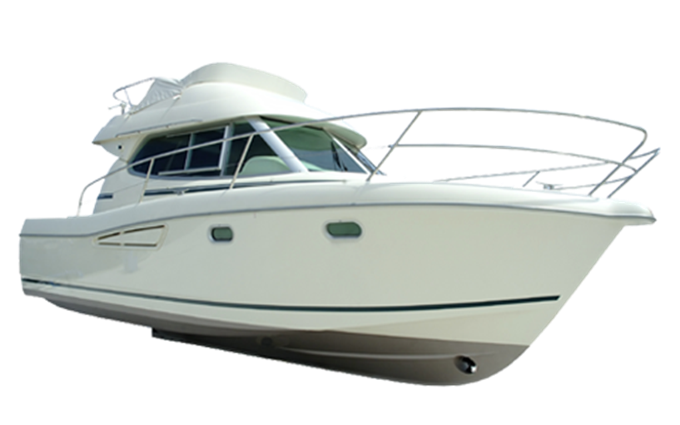
Boatbuilding
Notes:
Welding – joining 2 pieces of metal

Slide 30
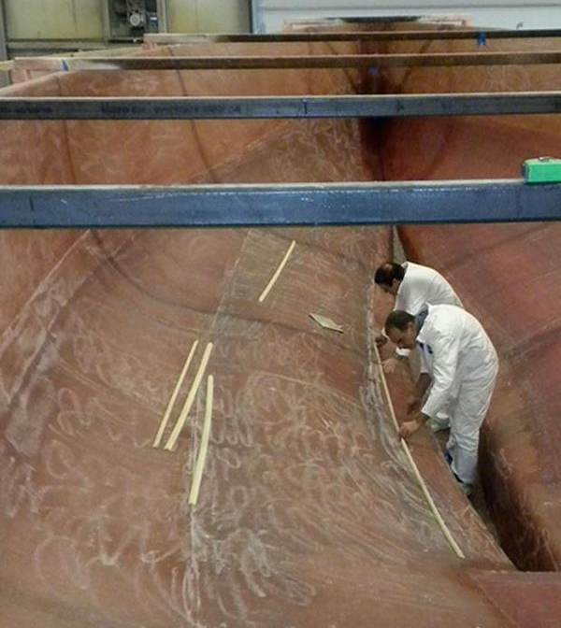
Boatbuilding
Mold – wood/plastic
Covered by brush or spray with resin/fiberglass
  Resins- polyesters, epoxies, polyamides, phenolics
  Solvents – styrene, methylethylketone(MEK), acetone, methanol
  Catalysts
  Pigments
Notes:
Welding – joining 2 pieces of metal

Slide 31
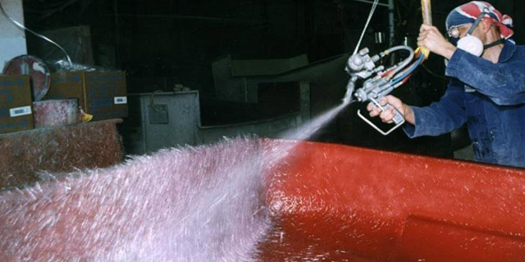
Boatbuilding
Notes:
Fiberglass or glass-reinforced plastic

Slide 32
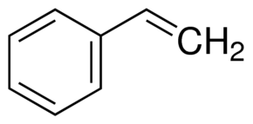
Styrene
Vinyl benzene (C8H8) – slightly yellow, oily liquid, pungent sweet odor
Acute exposure = mucosal irritation(115ppm), inebriation and ataxia (375ppm)
Chronic exposure = M/S neuropathy, neurobehavioral effects
Metabolized to styrene 7,8-oxide, decreases brain glutathione and leads to oxidative damage
Further metabolized to mendelic acid and phenyl glyoxylic acid
Notes:
Fiberglass or glass-reinforced plastic

Slide 33
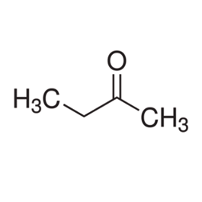
Methyl ethyl ketone
MEK, 2-butanone
Acute exposure – mucosal irritation, inebriation, headache
Little evidence of chronic neurotoxicity – studies include patients exposed to multiple solvents.
Notes:
Fiberglass or glass-reinforced plastic

Slide 34
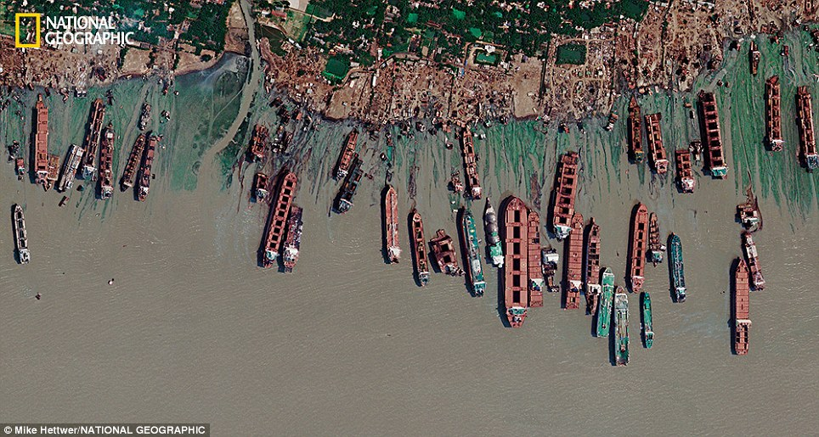
Shipbreaking
Notes:
Bangladesh

Slide 35
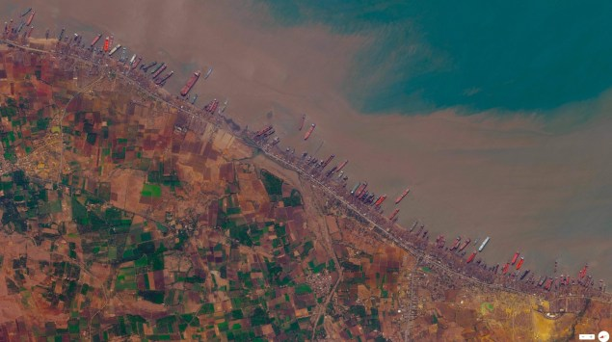
Shipbreaking
Notes:
India

Slide 36
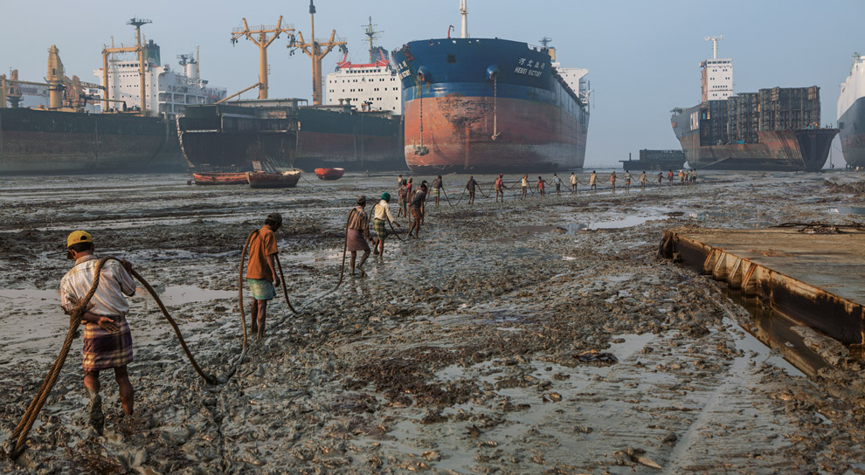
Shipbreaking
Notes:
Fiberglass or glass-reinforced plastic

Slide 37
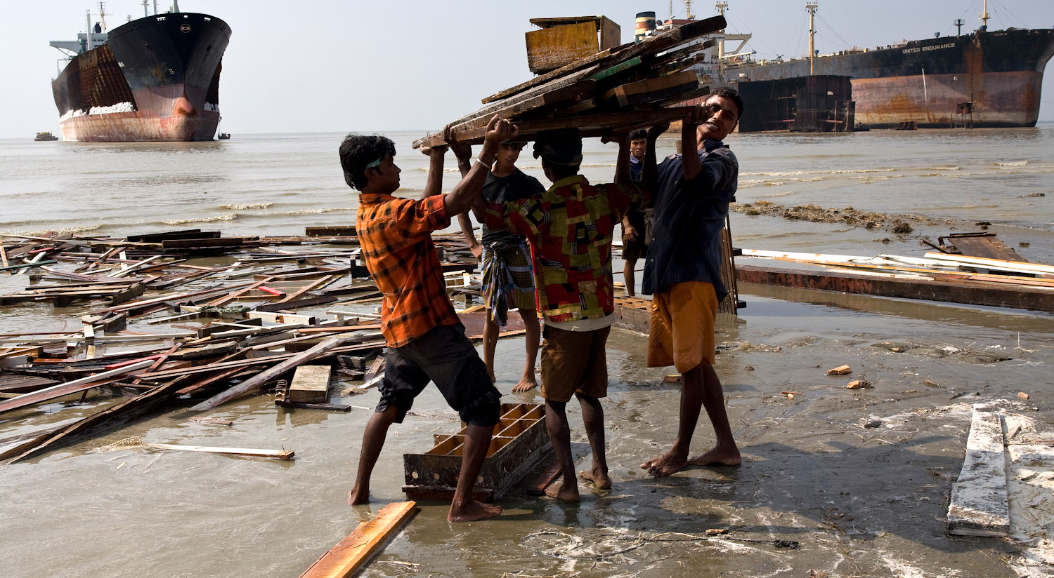
Shipbreaking
Notes:
Fiberglass or glass-reinforced plastic

Slide 38
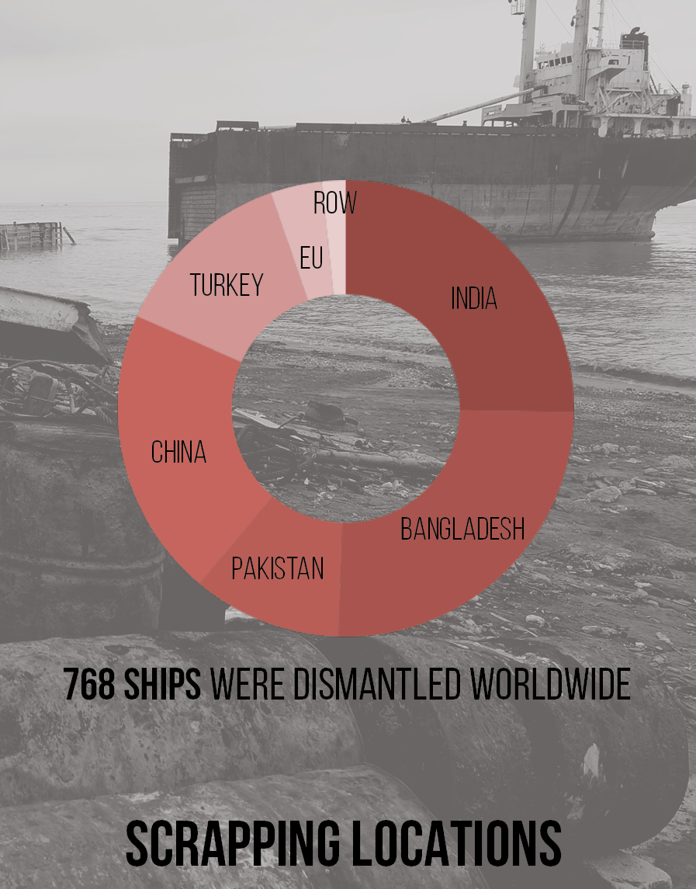
Shipbreaking
Notes:
Bangladesh

Slide 39
Ship building
Increasingly large business in the US and Thailand
  Enclosed spaces
  Silica, metals, solvents
  Copper
  Asbestos, MMFs
Notes:
Bangladesh

Slide 40
Boat building
Increasingly large business in the US and Thailand
  Enclosed spaces
  Solvents
  Styrene
  MEK
Notes:
Bangladesh

Slide 41
Ship breaking
Large business in India, Bangladesh, China
Occupational physical hazards
Toxicological hazards:
  Metals, asbestos, MMFs
  Paints, solvents
Notes:
Bangladesh

Slide 42

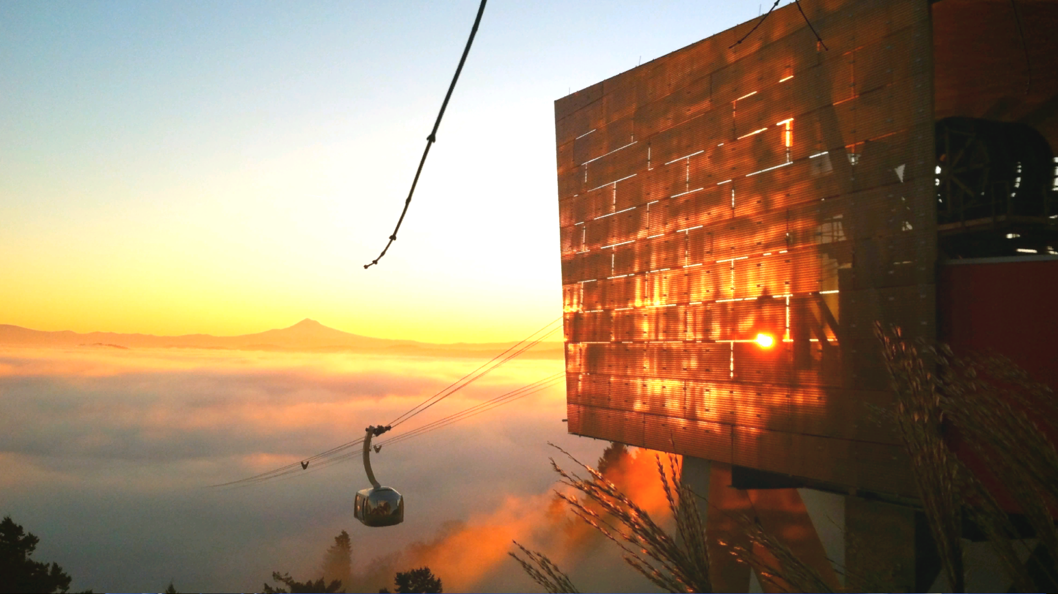
Questions and discussion…

